Slide 1
TU856-1 and TU858-1 Computer Architecture and Technology
Thursday 20 February 2025
(Week 4) Tutorial 2

Slide 2

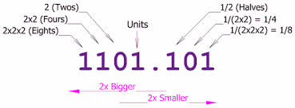
Questions and Answers ( 1 )
How can we consider the use of binary to represent all instructions and data on a computer system?
The two-state number system can be compared with ‘relay’ components and ‘switching’ – which makes up hardware architecture at its most fundamental levels.

Slide 3
Questions and Answers ( 2 )
A discursive investigation of Two’s Complement and how that works mathematically (as a method for subtraction and division).
Two’s Complement number conversion: 1₁₀
I.E. how do you find the decimal -1 in 8-bit binary?
0000 0001₂ (This is decimal 1 in 8-bit binary)
Flip 1s to 0s and 0s to 1s to get One’s Complement
1111 1110
Add a binary 1 to this to get Two’s Complement
1111 1111 (This can represent -1₂₎

Slide 4
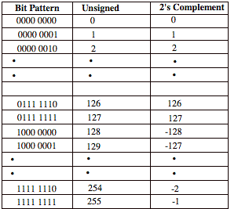
Two’s Complement again
Two’s Complement numbers can be used in calculations by the computer to have the effect of subtraction.
A few more examples on the right

Slide 5
Questions and Answers ( 3 )
What use has octal as a number base?
The use of three-place number systems.
Example
Older mainframe computers from 1950 and early 1960s used 12-bit, 24-bit or 36-bit words. Divisible by 3, so 3-bit octal labels fitted them for calculations.

Slide 6
Questions and Answers ( 4 )
What use has hexadecimal as a number base?
The use of four-place number systems.
Example
Computers from 1960s onward use 16-bit, 32-bit or 64-bit words. Divisible by 4, so 4-bit hexadecimal labels fit them for calculations.

Slide 7
Typical Exam (Sub) Question For This Content
Question
Give a brief description of binary, octal and hexadecimal number representations.
Sample solution
Binary
Computing machines operate on electrical current and so use two states. We view these states as the numbers 0 and 1.
This is the binary representation and is called 'Base 2'.
Whether in decimal or binary, the position of numbers delineate their quantity.

Slide 8
Solution continued
Octal
Grouping binary digits, for example, 010010101110011 into threes looks like this:
9,587₁₀ = |010|010|101|110|011₂
The Octal notation for representing Binary numbers uses groups of three bits:
The symbols that are used to represent each group are the same as the integer value of each group. By using these Octal symbols (0 - 7), the number can be expressed in a more compact form:
9,587₁₀ = (2|2|5|6|3) ₈

Slide 9
Solution continued
Hexadecimal
Suppose that we group the example binary digits 010010101110011 into fours. Then this might be written:
9,587₁₀ = |0010|0101|0111|0011₂
Now the groups of four can be given different symbols.
There are 16 different combinations of four binary digits.
The symbols chosen are the common numerals (0 - 9) and the remaining six possible four-bit combinations are represented by the letters, A, B, C, D, E and F.
(10 marks)

